Slide 1

Insightful Learning
The "Aha!" Moment in Human Problem Solving
Course : Introduction to Psychology
Presented By
Team NeuroVision
1st Year, B.Sc. (Honours) in Psychology
Presented To
FEUJI AKTER
Assistant Professor
Department of Psychology
University of Rajshahi
Date: 22 July 2026

Slide 2
TEAM NEUROVISION
"Together We Think, Together We Discover."
Team Members
01. Ditton Biswas
02. Muslima Naznin Mou
03. Akil Ahamed
04. Bonna Borsha
05. Sainar Ali Mohan

Slide 3
What is Insightful Learning?
Definition:
A type of cognitive learning where a solution to a problem appears suddenly, without systematic trial-and-error.
A type of cognitive learning where a solution to a problem appears suddenly, without systematic trial-and-error.
A The "Aha!" Moment: Also known as the Eureka effect.
Core Concept: It involves understanding the inner relationships of a situation.
It is a cognitive process rather than just mechanical habit formation.

Slide 4
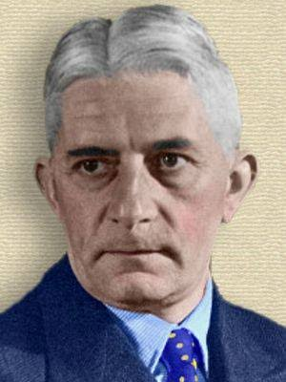
Gestalt Psychology and Wolfgang Köhler
Origin:Rooted in Gestalt Psychology (focuses on the "whole" rather than parts).
Key Figure: Wolfgang Köhler (German Psychologist, 1887–1967).
Key Literature: "The Mentality of Apes" (Published in 1925).
Famous Statement: "The whole is greater than the sum of its parts."

Slide 5
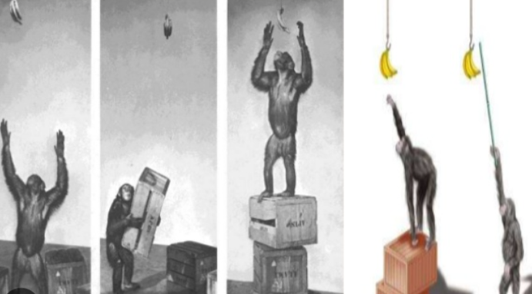
Köhler’s Landmark Experiment
Subject: A chimpanzee named Sultan.
The Problem: Bananas were hung from the ceiling, out of Sultan’s reach.
Available Tools: Boxes and hollow bamboo sticks inside the cage.
Observation: * Sultan tried jumping (failed).
He sat down, observed the boxes and sticks, and analyzed the situation.
Suddenly, he stacked the boxes and connected the sticks to reach the bananas.

Slide 6
Key Characteristics of Insightful Learning
Suddenness: The solution comes all of a sudden.
Understanding Relationships: Understanding the connection between the problem and the available tools.
Permanent Retention: Once solved by insight, the learner rarely forgets the solution.
Transfer of Learning: The solution found in one situation can be applied to similar other situations.

Slide 7
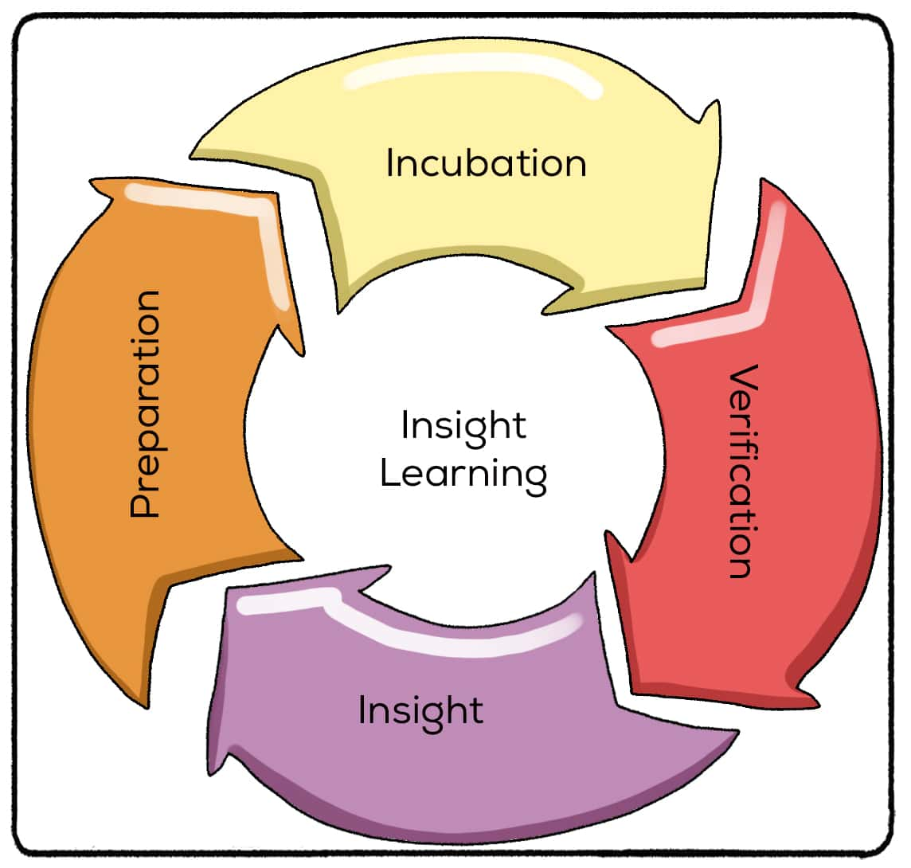
Four Stages of Insight
1. Preparation
Gathering information and trying to solve
the problem initially.
2. Incubation
Taking a break; the unconscious mind
processes the problem.
3. Illumination
The "Aha!" moment; the solution suddenly flashes in the mind.
4. Verification
Testing the solution to see if it actually works.

Slide 8
Trial & Error vs. Insightful Learning
Trial & Error Learning | Insightful Learning
Proposed by E.L. Thorndike. | Proposed by Wolfgang Köhler.
Gradual process through repetitive attempts. | Sudden process through understanding.
Blind and mechanical efforts. | Intelligent and cognitive efforts.
Role of understanding is minimal. | Highly dependent on perception & intelligence.

Slide 9
Factors Influencing Insightful Learning
Intelligence: Higher intelligence leads to quicker and better insight.
Past Experience: Past knowledge helps in reorganizing the current situation.
Learning Environment: Availability of tools and clear perception of the field.
Effort & Presentation: How the problem is structured or presented to the learner.

Slide 10
Educational Implications
Promotes Critical Thinking: Encourages students to understand concepts rather than memorizing.
Problem-Solving Skills: Helps students become independent problem solvers.
Integrated Curriculum: Subject matters should be presented as a "whole" rather than isolated facts.
Role of Teacher: Teachers should act as facilitators, guiding students to find answers themselves.

Slide 11
Conclusion & References
Conclusion: Insightful learning bridges the gap between perception and higher-order thinking. It proves that learners are active processors of information, not just passive observers.
References:
Köhler, W. (1925). The Mentality of Apes.
Morgan, C. T., & King, R. A. Introduction to Psychology.
Standard Web Resources on Gestalt Psychology.
Thank You!
Any Questions?

